Slide 1
Taxonomy of Viruses
Dr.Sonal Mishra

Slide 2

Taxonomy of Viruses

Slide 3
Classification of Viruses
International committee on taxonomy of viruses (ICTV):
[phylum - class] – order (-virales) – family (-viridae) – subfamily (-virinae) – genus (-virus) - species - strain/type
–Currently: the viral species (group of viruses that share the same genome & the same relationship to organisms) is written in English not Latin.
e.g. HIV virus: family Retroviridae, genus Lentiviridae, spp. Human immunodeficiency virus.
As of 2017, 9 orders, 131 families, 46 subfamilies, 803 genera, and 4,853 species of viruses have been defined by the ICTV.
–Virus families are often distinguished based on:
nucleic acid type,
capsid symmetry (shape) and number of capsomeres
envelope
size
Host range and target cells

Slide 4
Classification of Viruses
•Nucleic acid classification
–Major groups are classified first as DNA or RNA viruses.
–Subdivisions are based on properties of nucleic acid; single stranded (ss) or double stranded (ds).
–Since eukaryotic cells don’t have enzymes to copy viral RNA molecules, RNA viruses must have enzymes or genes for the enzymes that are needed to copy the viral RNA molecules.
–ssRNA viruses contain either (+)sense RNA i.e. RNA acts as mRNA that can be translated by host ribosomes, or anti-sense /(-)sense RNA: RNA acts as template during transcription to make complementary (+)sense mRNA which will be translated by host ribosomes.
–(-) sense virus must carry RNA polymerase within virion.
Notes:
Positive-sense ssRNA viruses have genetic material that can function both as a genome and as messenger RNA; it can be directly translated into protein in the host cell by host ribosomes.

Slide 5
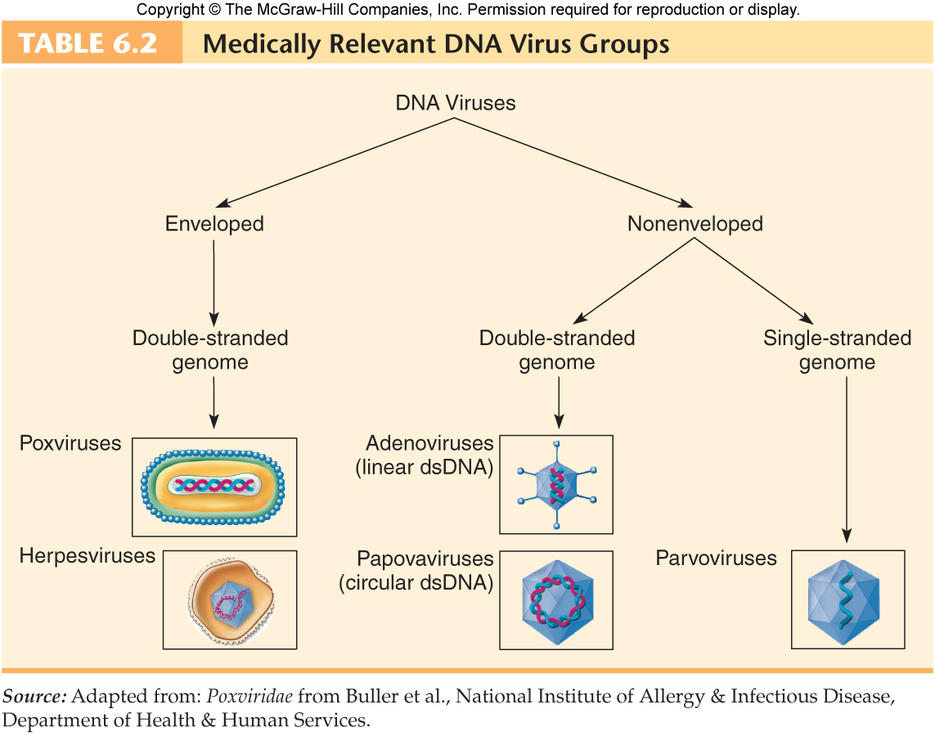

Slide 6
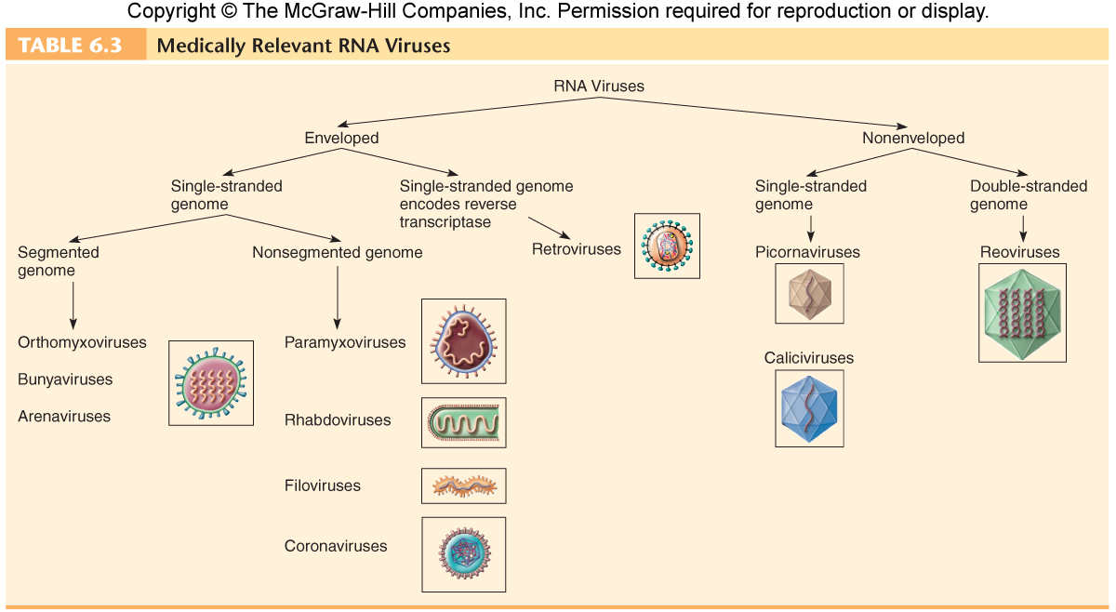

Slide 7
Classification of Viruses - Examples
•RNA viruses
–Enteroviruses
Non-enveloped (+)sense ssRNA viruses from the family Picornaviridae.
E.g. poliovirus (which causes poliomyelitis).
They are resistant to chemicals & can replicate in & pass through GIT & spread to the nervous system.
They spread through the fecal-oral route.

Slide 8
Classification of Viruses - Examples
•RNA viruses
–Retroviridae
Enveloped viruses having two copies of (+)sense ssRNA.
Also contain the enzyme reverse transcriptase.
The following pattern is followed for protein synthesis:
1. Viral RNA is reverse-transcribed into DNA by reverse transcriptase.
2.The DNA is integrated into the host’s genome by integrase enzyme, this integrated DNA is known as a provirus.
3.The provirus (DNA) is then transcribed into RNA.
4.The resultant RNA is finally translated into polypeptides (proteins). Retroviruses causes AIDS (HIV), tumors & leukemias (HTLV-1).

Slide 9
Retroviruses - example
Human immunodeficiency virus (HIV) is the cause of acquired immune deficiency syndrome (AIDS).
HIV is able to attach and invade cells bearing receptors that the virus recognizes and the most important of these receptors is CD₄ receptors.
Cells possessing CD₄ receptors are called CD₄+ cells.
The most important CD₄+ cells is; helper T cells and macrophages.

Slide 10
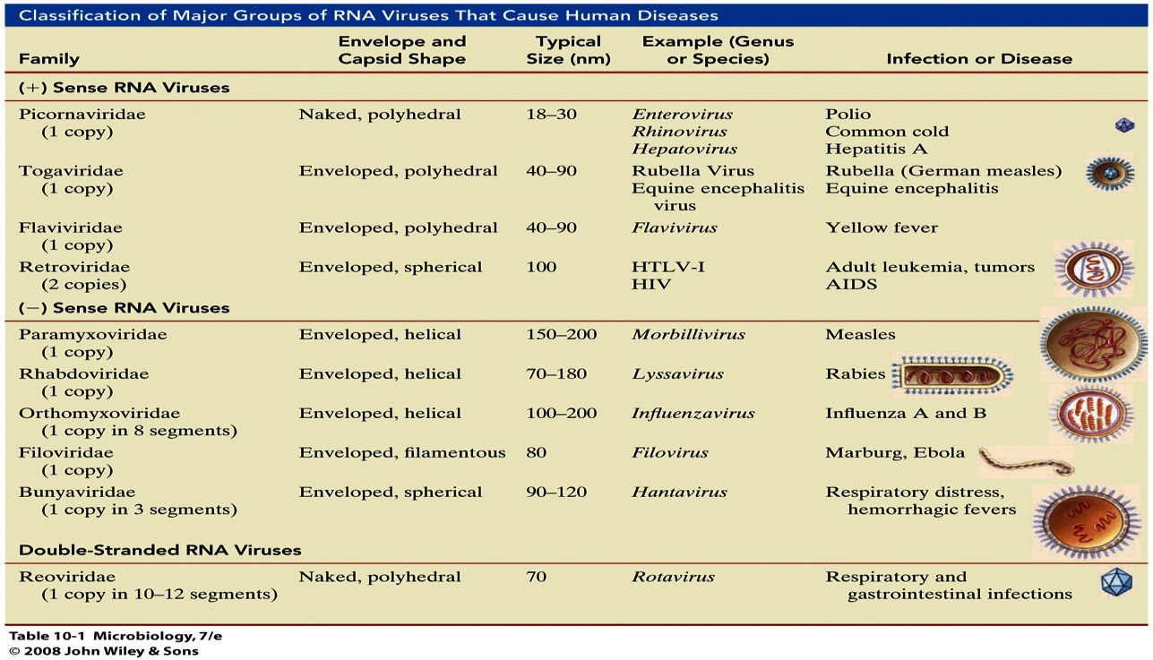

Slide 11
Classification of Viruses - Examples
•DNA viruses
–Herpesviridae (herpesviruses)
Enveloped dsDNA viruses.
E.g. Herpes simplex virus 1&2, varicella-zoster virus, cytomegalovirus and Epstein-Barr virus.
Widely distributed in nature & most animals are infected with herpesviruses (one or more of them).
When cells are infected with some herpesviruses, the viral DNA can become a provirus and exhibit ‘latency’.
Viral latency indicates the virus ability to remain in host cells, usually neurons, for long time.
The latent virus can be reactivated later to cause a new episode of a disease, e.g. varicella-zoster virus: initial infection causes chickenpox, after the disease is resolved, the virus can remain latent in neurons.
Reactivation of the virus (due to stress or other factors) at later age causes shingles (zoster).

Slide 12
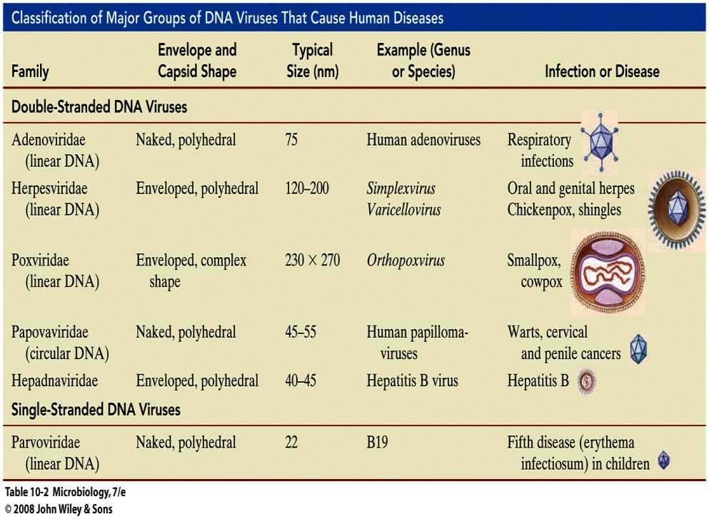

Slide 13
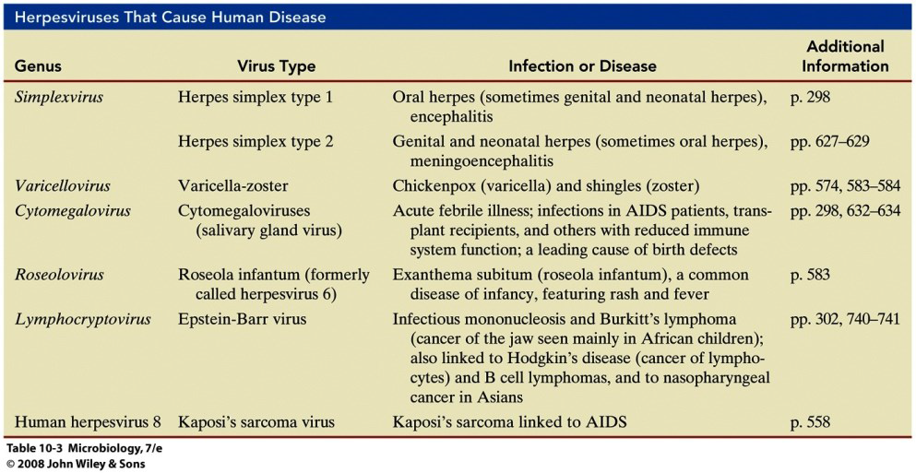

Slide 14
Emerging Viruses
•Some viruses caused infections since 1000s of years ago.
•But microbiologists believe that many recent unexpected viral diseases are caused by ‘emerging viruses’.
•Emerging viruses may result from:
Viruses that have crossed the ‘host species barrier’, i.e. an animal virus acquiring the ability to infect humans. e.g. Influenza virus: if a host cell is simultaneously infected by 2 different viruses (e.g. human, swine) they can swap parts of their genomes → new mutant type occur → resulting in “a chimeric virus or chimera”, for example, human flu virus covered by bird or pig type capsid, that is a new virus which is not recognized by human immune system, another example is Covid-19.

Slide 15
Emerging Viruses
Viruses which were endemic (low level of infection in localized area) and then spread world-wide (epidemic or even pandemic).
e.g. poliovirus was endemic since ancient times, but after 1900 it was spread world-wide due to urbanization and migration.
Note: RNA viruses mutate faster than DNA viruses, single-stranded viruses mutate faster than double-strand virus, and genome size appears to correlate negatively with mutation rate (Viruses with smaller genomes tend to mutate faster).

Slide 16
Classification of Viruses
Viruses are also classified according to host range into:
Bacteriophages (viruses that infect bacteria).
Animal viruses (viruses that infect animals and human).
Plant viruses (viruses that infect plants).

Slide 17
Bacteriophages (Phages)
•Bacteriophages (literally means eater of bacteria) are viruses that infect and replicate within bacterial cells.
•Bacteriophages are highly specific in term of their host and hence they have been used to treat bacterial diseases (phage therapy).
•Advantages of phage therapy:
Cheap, rapid (cures in 1-2 days) and effective in small doses.
Can be used to treat long term antibiotic-resistant bacterial infections.
Selectivity: attacking only targeted bacteria without affecting human cells or the beneficial normal flora.
Rarely cause side effects.

Slide 18
Bacteriophages (Phages) - Example
•T-Even phages
–The letter ‘T’ indicates ‘type’ and the word ‘even’ indicates ‘even number’, i.e. T2, T4 and T6.
–They are dsDNA viruses that infect E. coli cells.
–They have a characteristic structure which is made of:
1.Head: a polyhedral capsid surrounding the nucleic acid core.
2.Collar: joining the virus head to its tail.
3.Tail: a hollow helical protein used to pass the nucleic acid into the host cell after attachment.
4.Tail fibers: serve for recognition and attachment to host cells.

Slide 19
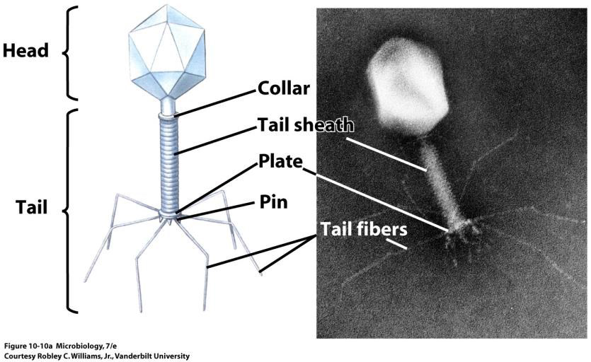

Slide 20
Viral Taxonomy
Family names end in -viridae
Genus names end in -virus
Viral species: A group of viruses sharing the same genetic information and ecological niche (host).
Common names are used for species
Subspecies are designated by a number

Slide 21
Viral Taxonomy Examples
Herpesviridae
Herpesvirus
Human herpes virus 1, HHV 2, HHV 3
Retroviridae
Lentivirus
Human Immunodeficiency Virus 1, HIV 2

Slide 22
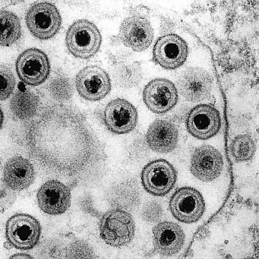
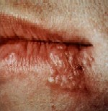
Herpes Virus
SIMPLEX I and II

Slide 23
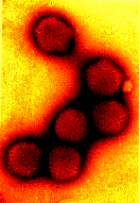
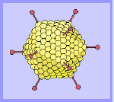
Adenovirus
COMMON COLD

Slide 24
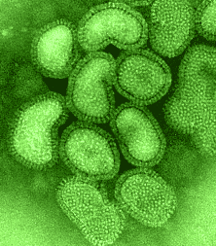
Influenza Virus

Slide 25

Chickenpox Virus

Slide 26
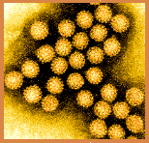
Papillomavirus – Warts!

Slide 27
Used for Virus Identification
RNA or DNA Virus
Do or do NOT have an envelope
Capsid shape
HOST they infect

Slide 28
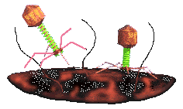
Bacteriophages

Slide 29
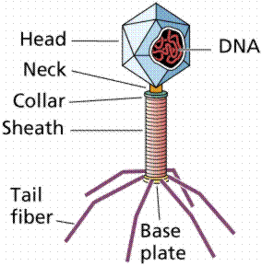
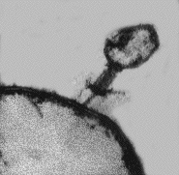
Phages
Viruses that attack bacteria are called bacteriophage or just phage
T-phages are a specific class of bacteriophages with icosahedral heads, double-stranded DNA, and tails

Slide 30

T-phages
The most commonly studied T-phages are T4 and T7
They infect E. coli , an intestinal bacteria
Six small spikes at the base of a contractile tail are used to attach to the host cell
Inject viral DNA into cell

Slide 31
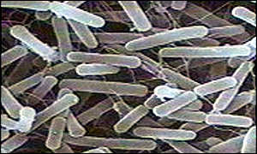
Escherichia Coli Bacterium
T - EVEN PHAGES ATTACK THIS BACTERIUM

Slide 32
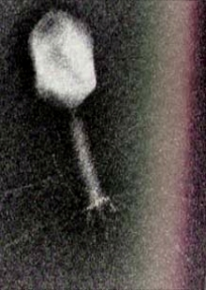
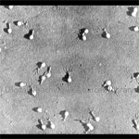
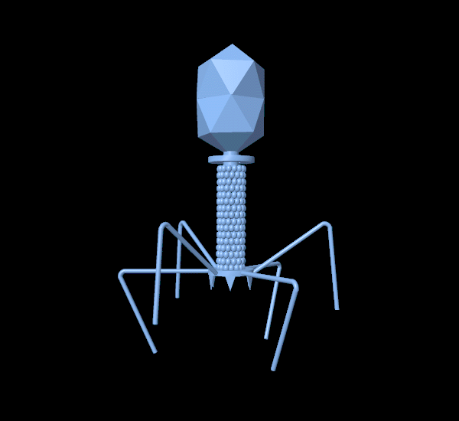
T-Even Bacteriophages

Slide 33
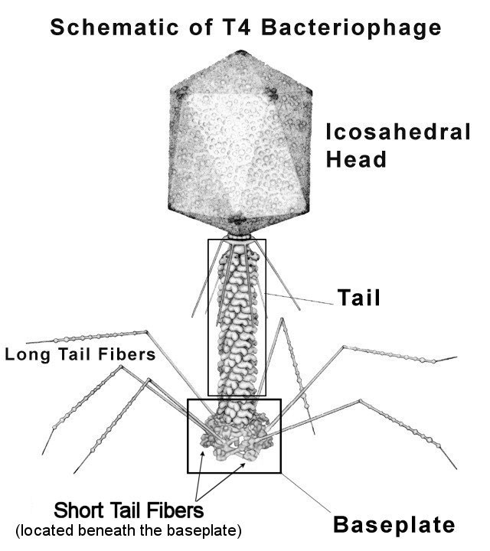
Diagram of T-4 Bacteriophage
Head with 20 triangular surfaces
Capsid contains DNA
Head & tail fibers made of protein

Slide 34
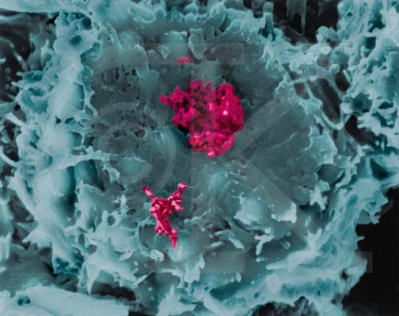
Retroviruses

Slide 35
Characteristics of Retroviruses
Contain RNA, not DNA
Family Retroviridae
Contain enzyme called Reverse Transcriptase
When a retrovirus infects a cell, it injects its RNA and reverse transcriptase enzyme into the cytoplasm of that cell

Slide 36
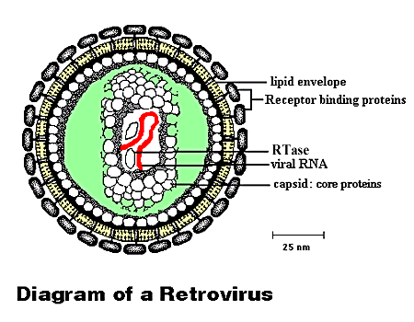
ENZYME

Slide 37
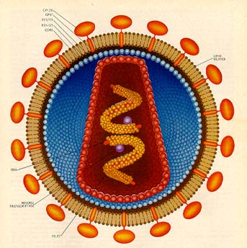
Retroviruses
The enzyme reverse transcriptase (or RTase), which causes synthesis of a complementary DNA molecule (cDNA) using virus RNA as a template
RTase

Slide 38
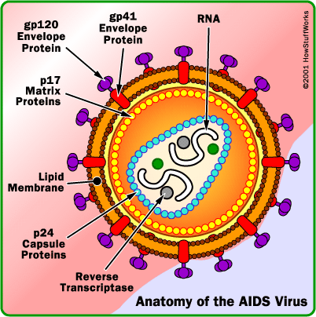
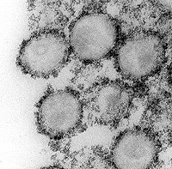
Retroviruses
HIV, the AIDS virus, is a retrovirus
Feline Leukemia Virus is also a retrovirus

Slide 39


